Slide 1
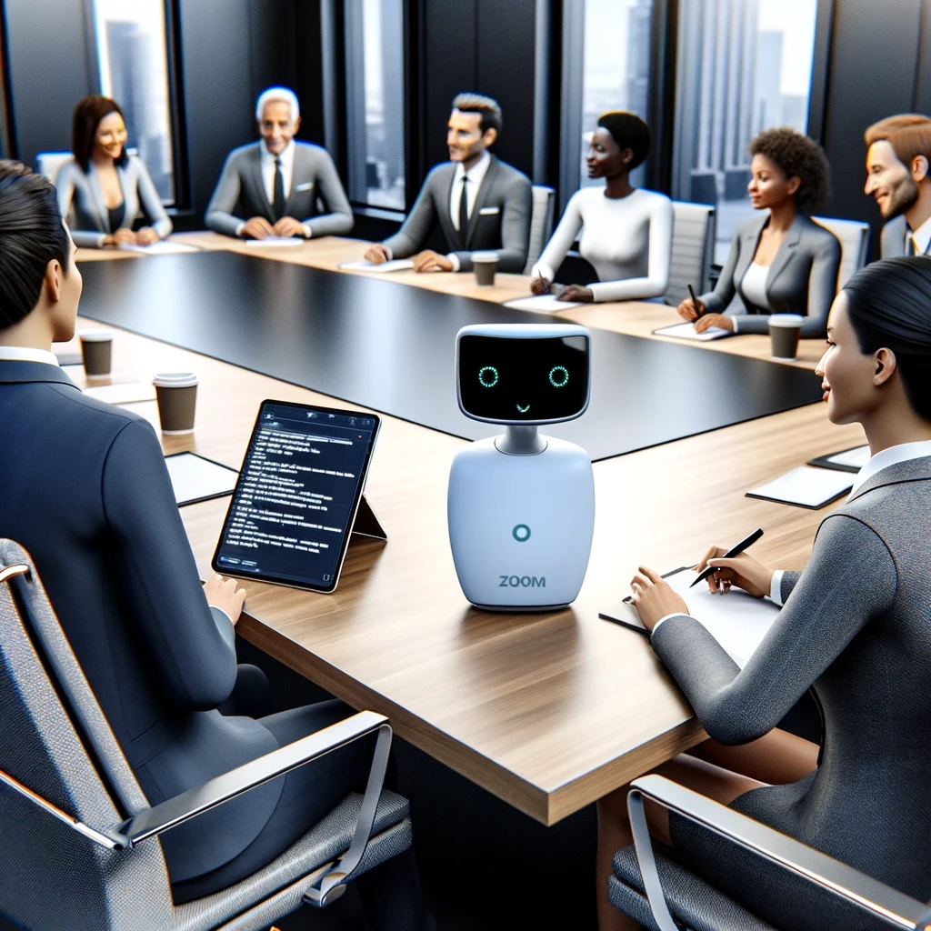
Using Zoom AI Companion Smart Recordings Part 3

Slide 2

“I’ve become an expert at nodding and looking interested on Zoom calls, even when I have no idea what people are talking about.”

Slide 3




Notes:
https://www.youtube.com/channel/UC35ZpwldGw7ZJ5R-2sLijzw

Slide 4
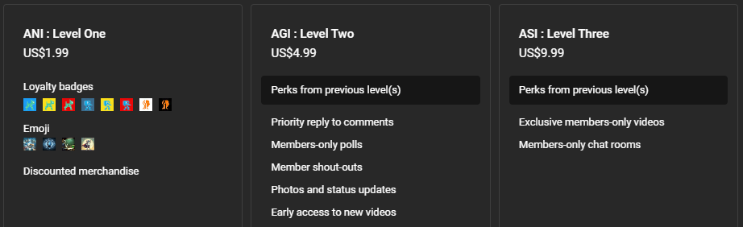
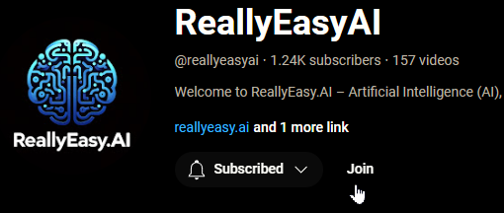
Membership has its privileges
Notes:
https://www.youtube.com/channel/UC35ZpwldGw7ZJ5R-2sLijzw/join

Slide 5

Zoom AI companion Smart Recordings
Notes:
https://support.zoom.com/hc/en/article?id=zm_kb&sysparm_article=KB0061101

Slide 6
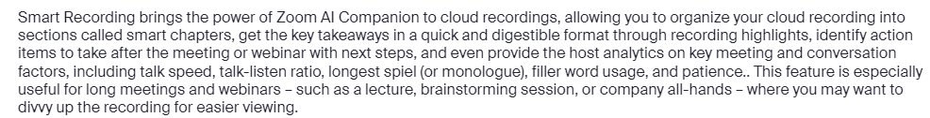


Slide 7
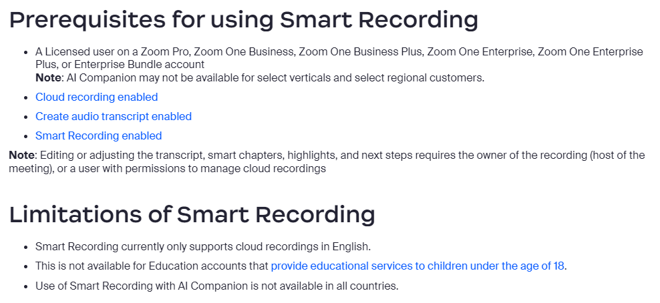

Slide 8
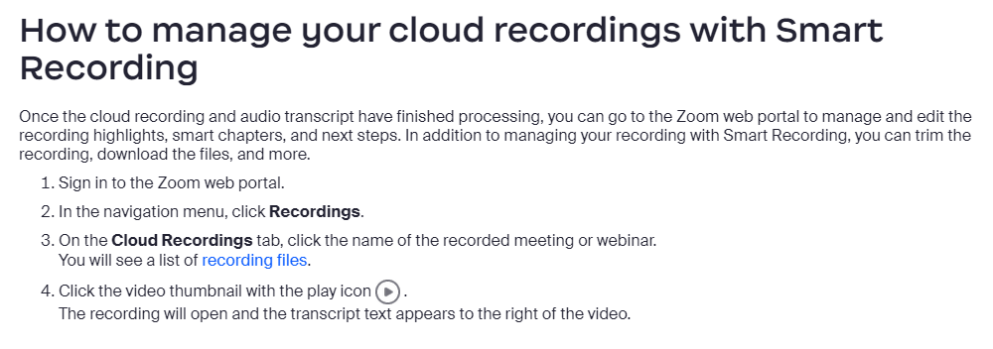

Slide 9
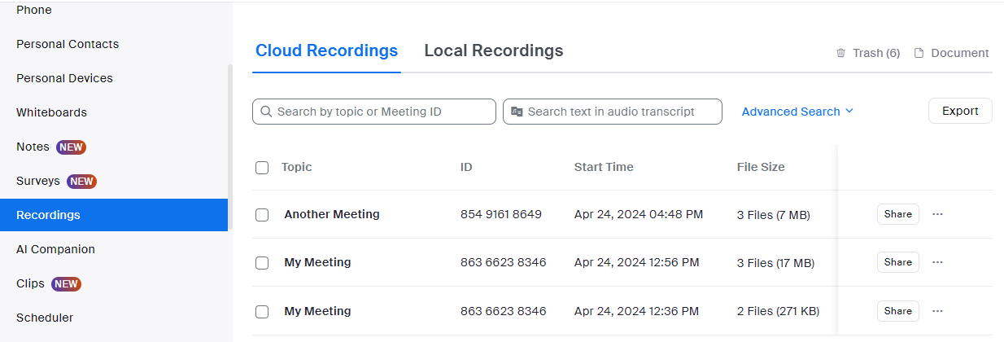
Demo: Manage Smart Recordings

Slide 10

Recording Highlights
Notes:
https://support.zoom.com/hc/en/article?id=zm_kb&sysparm_article=KB0061101

Slide 11
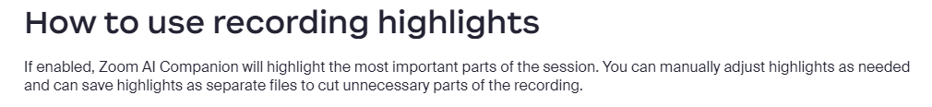

Slide 12
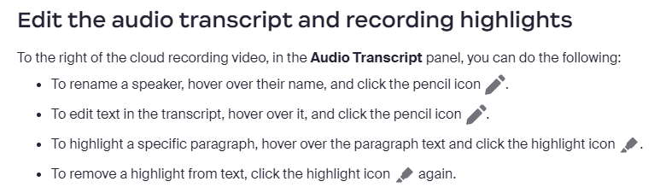

Slide 13
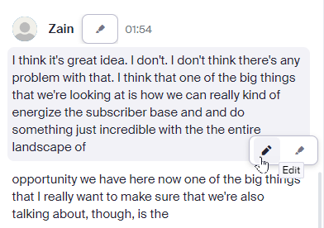
Demo: Editing the Audio Transcript

Slide 14
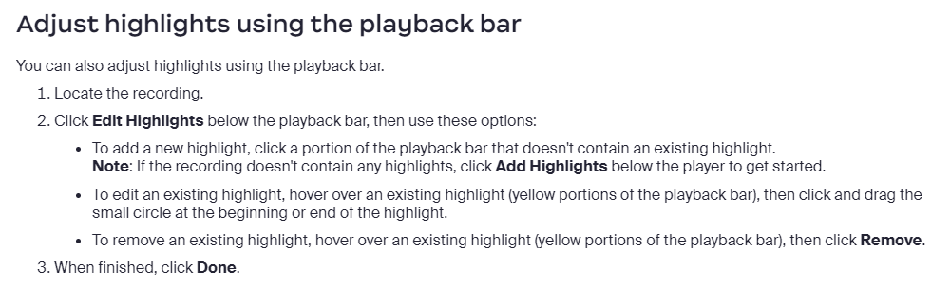

Slide 15
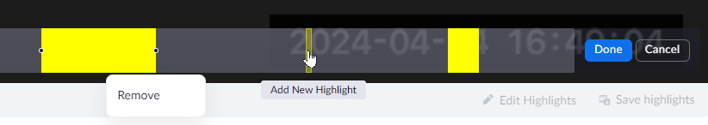
Demo: Adjusting Highlights using the playback bar

Slide 16
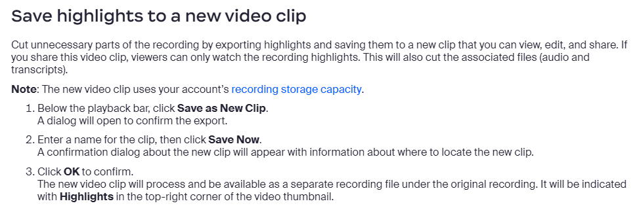

Slide 17
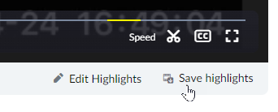
Demo: Saving Highlights to a new clip

Slide 18
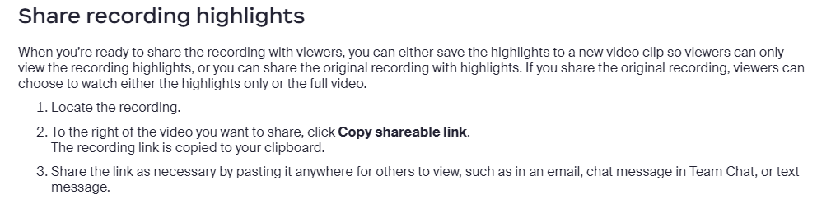

Slide 19

Smart Chapters

Slide 20
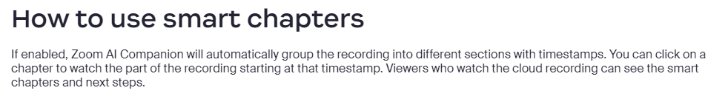

Slide 21
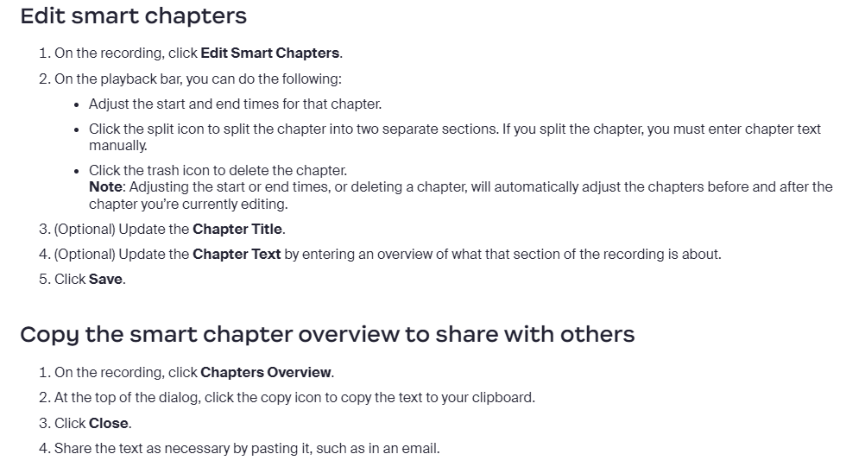

Slide 22
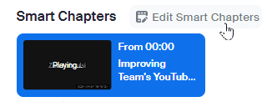
Demo: Working with smart chapters

Slide 23
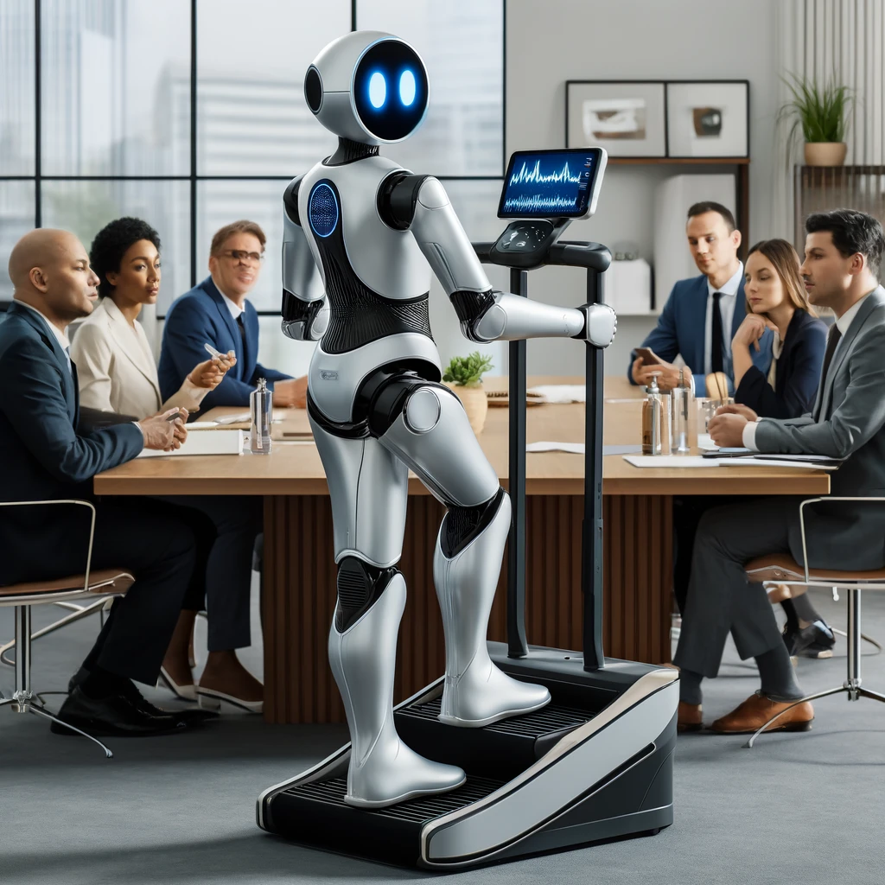
Next Steps

Slide 24
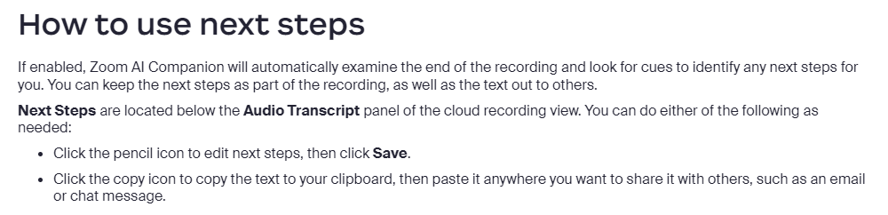

Slide 25
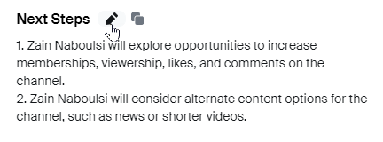
Demo: Using Next Steps

Slide 26

Coaching Analytics

Slide 27
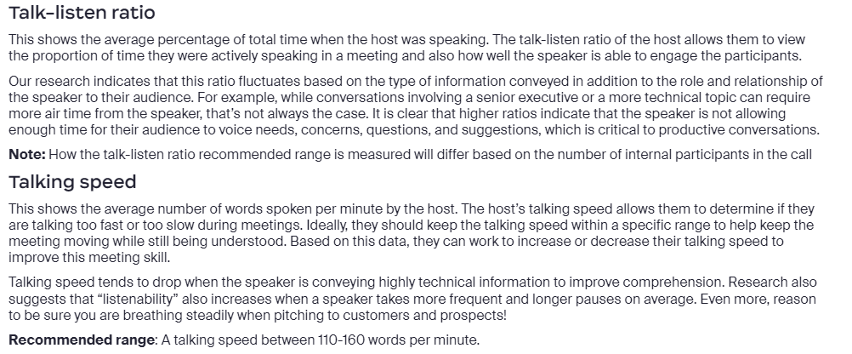

Slide 28
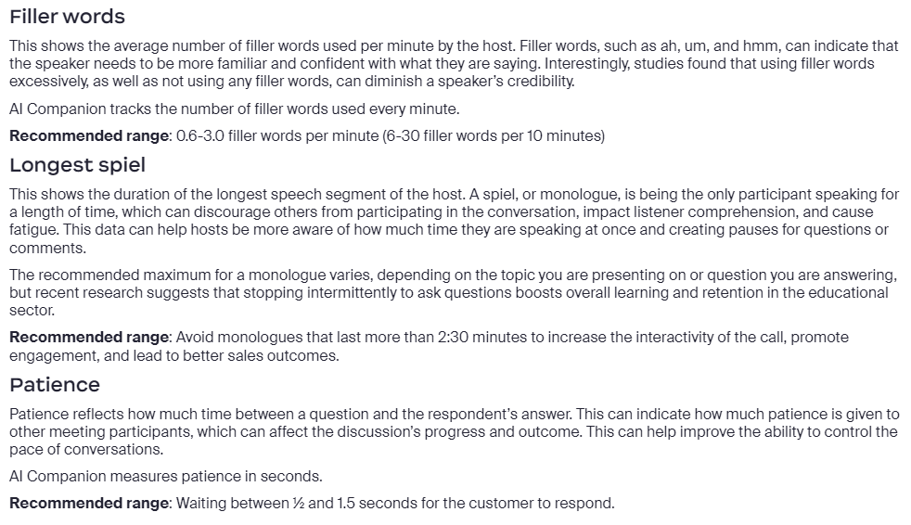

Slide 29
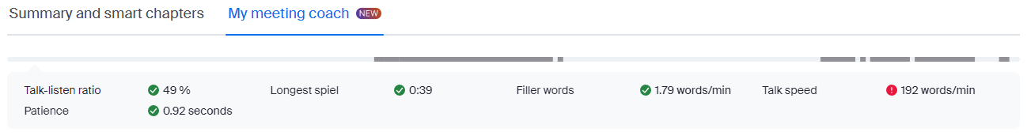
Demo: Coaching Analytics

Slide 30


